Slide 2

ABP: Open source web application framework for ASP.NET Core 3.0
github.com/abpframework
Halil İbrahim Kalkan Software Architect & Co-founder @ Volosoft

Slide 3
Why we’ve created the ABP framework?

Slide 4

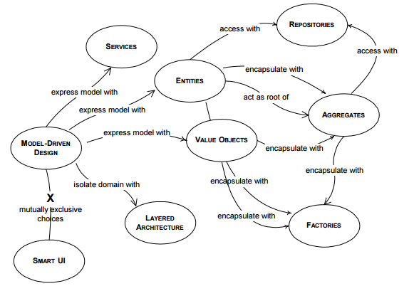
Why we’ve created the ABP framework?
Domain Driven Design
Your Application
Cross Cutting Concerns
Authorization
Validation
Exception Handling
DB Connection Management
Audit Logging
Caching
...
Infrastructure
Base Classes
Abstractions
Integrations
Extension Methods / Helpers
Library Wrappers
…
(plain) ASP.NET Core

Slide 5

Why we’ve created the ABP framework?
It’s hard to;
Develop
Maintain / Keep up to date
Document
Train developers
Needs a dedicated framework team!
Your Application(s)
Reusable
Application Framework
(plain) ASP.NET Core

Slide 6
Architecture

Slide 7
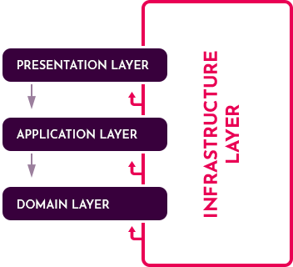
Architecture / Domain Driven Design
Based on DDD patterns & principles
Layers: Domain, Application, Presentation and Infrastructure.
Well structured startup templates
Infrastructure for entities, repositories, unit of work, application services… etc.
Documentation & best practice guides

Slide 8
Architecture / Modularity
Application
Pre-Built Modules
Account Management
Identity Management
Tenant Management
Setting Management
Permission Management
…
Module A
Entities, Services, APIs, UI Pages, DB
Module B
Entities, Services, APIs, UI Pages, DB
Module C
Entities, Services, APIs, UI Pages, DB
Module D
Entities, Services, APIs, UI Pages, DB

Slide 9
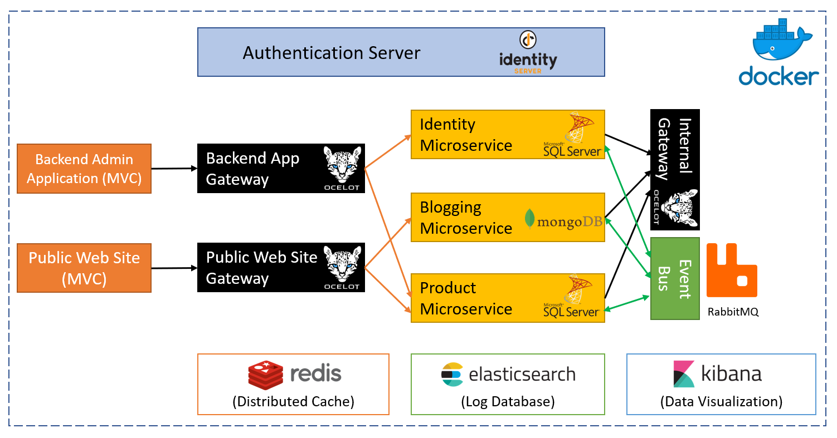
Architecture / Microservices
Designed microservices in mind
Communication patterns
Remote API calls
Distributed events (pub/sub model)
IdentityServer4 integration
Pre-built modules have been designed as microservice compatible.
A complete microservice solution sample!

Slide 10
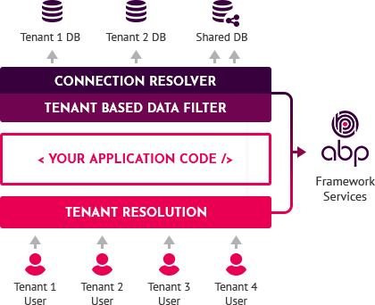
Architecture / Multi-Tenancy
Multi-tenant infrastructure
Tenant determination, auto data isolation, dynamic database selection, tenant basis setting system… etc.
Multi-tenancy unaware applications!
Pre-built tenant management module to create and manage your tenants!

Slide 11
ABP.IO vs ASP.NET Boilerplate

Slide 12
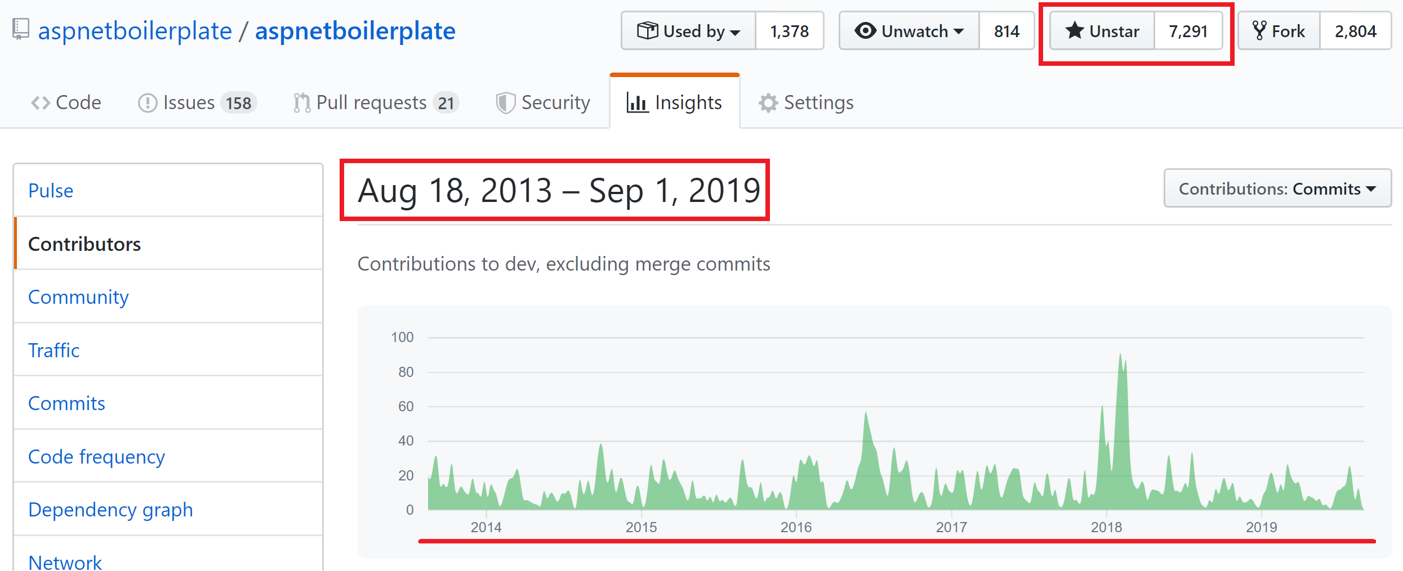
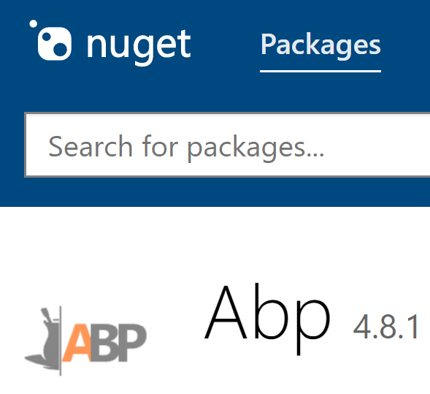
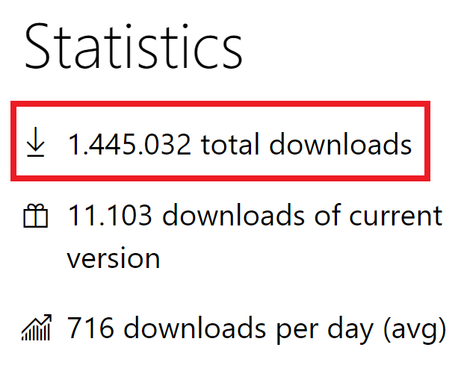

ASP.NET Boilerplate vs ABP.IO
6 years of continuous development
7,000+ stars on GitHub
1,5M downloads on NuGet

Slide 13
Demo: Create a new solution!

Slide 14
Highlights / Features

Slide 15
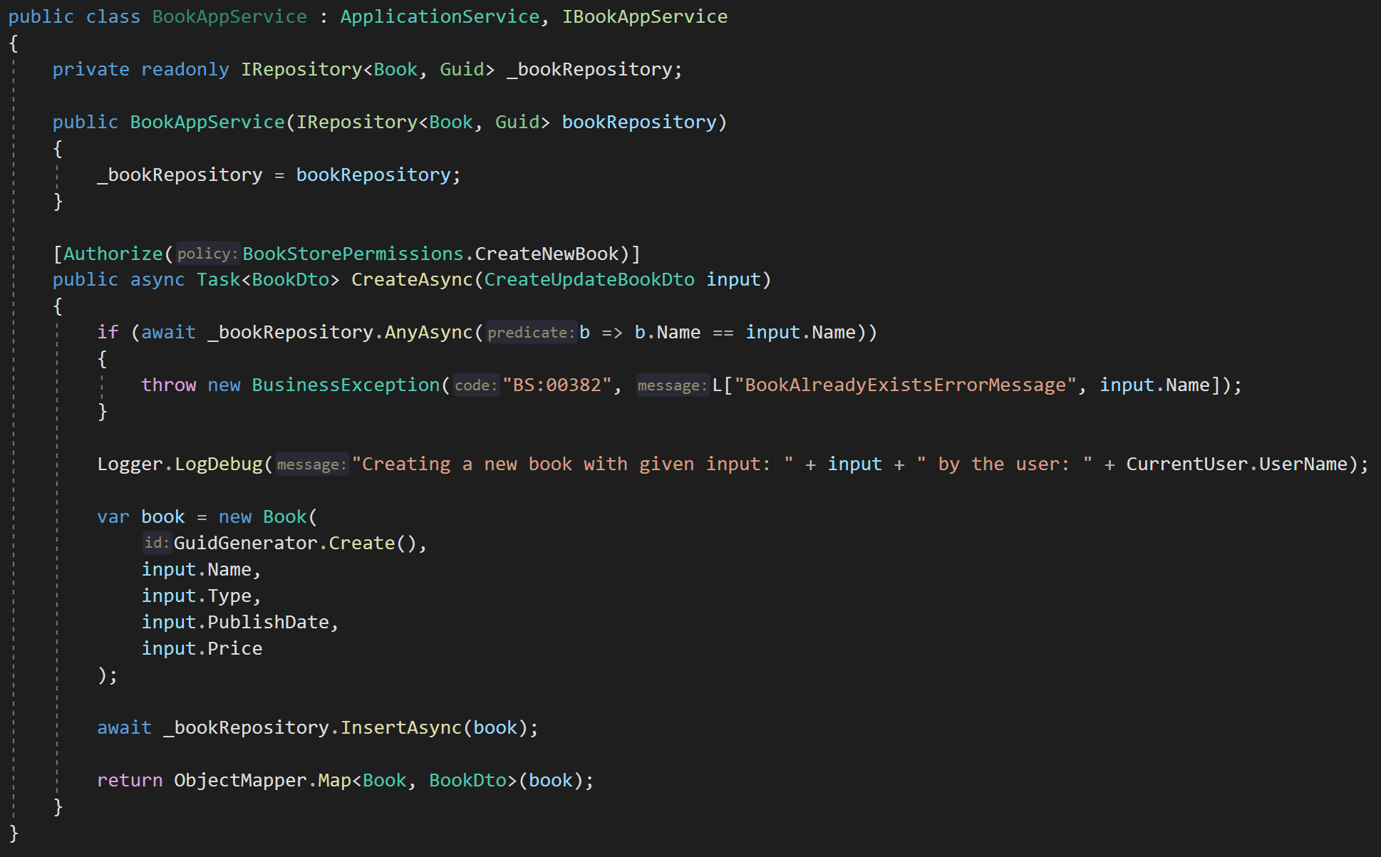
Cross-Cutting Concerns / Base Services
DDD Base Classes
DI Auto-Register
Generic Repositories
Authorization / Permissions
Auto Validation
Unit Of Work (Transaction Management)
Auto Audit Logging
Localization
Exception Management & Handling
ICurrentUser
ISettingProvider
IFeatureChecker
IGuidGenerator …
Object2Object Map

Slide 16
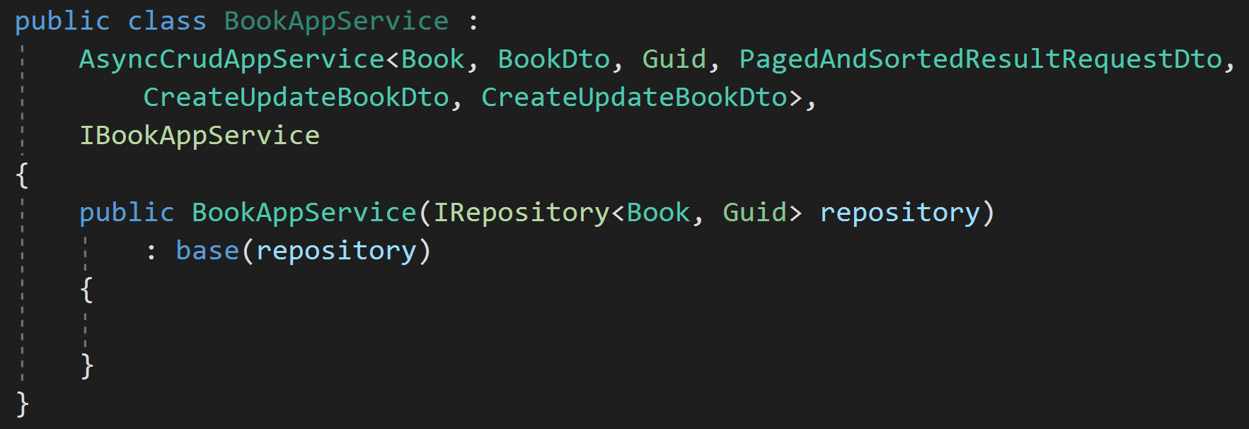
Cross-Cutting Concerns / Base Services
CrudAppService: CRUD Application Service Base
Get
Get List
Create
Update
Delete

Slide 17
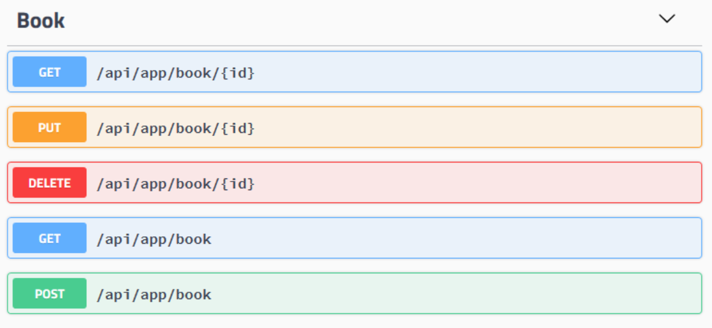
Auto HTTP API Controllers
Application Service (POCO)
HTTP API
By convention

Slide 18


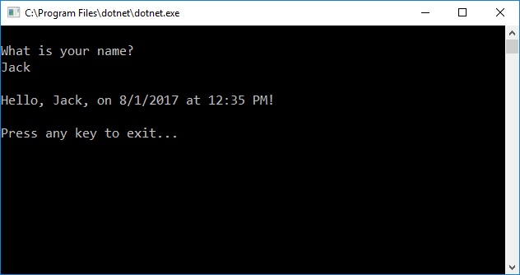

Dynamic JavaScript & C# Client Proxies
Browser
JavaScript Proxy
3rd-party client
C# Proxy
Authentication
Exception Handling
JSON De/serialization
Endpoint Configuration
NO CODE GENERATION!

Slide 19
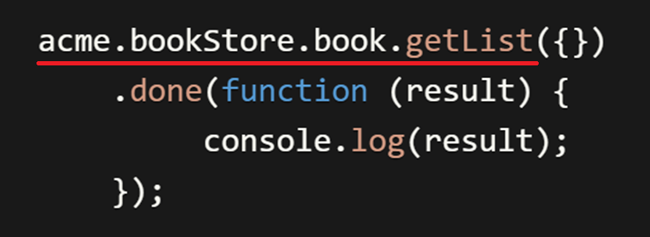
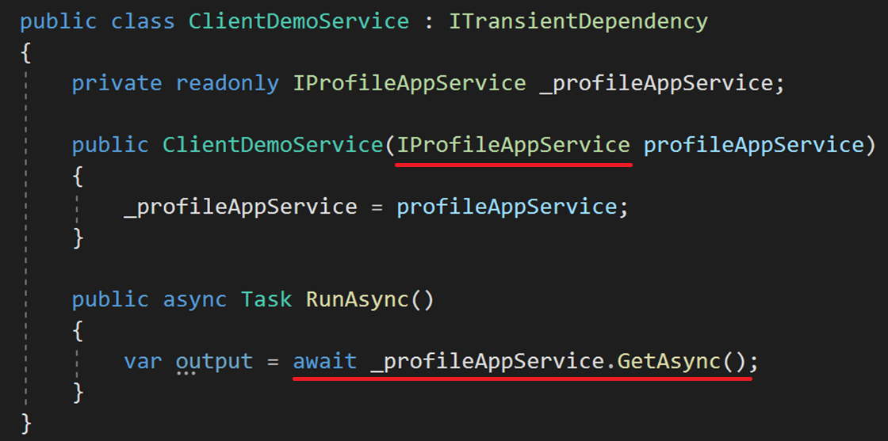
Dynamic JavaScript & C# Client Proxies
JavaScript Client
C# Client

Slide 20
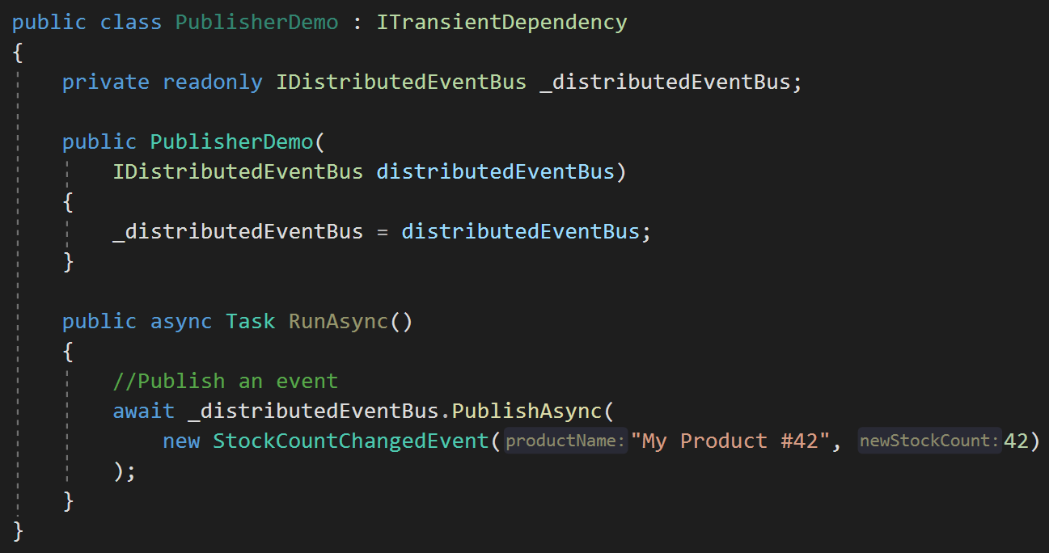
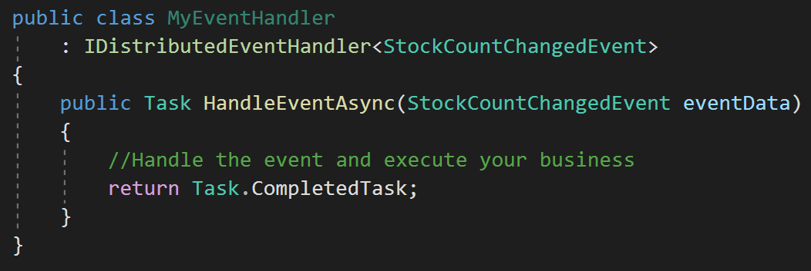

Distributed Event Bus
Publish Events / IDistributedEventBus
Consume Events / IDistributedEventHandler
Integrated with

Slide 21
MVC (Razor Pages) UI

Slide 22
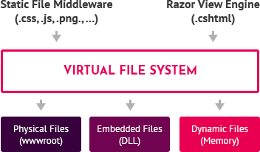
The Virtual File System
Embed Views, JavaScript, CSS… files into modules (dlls).
Integrated to razor view engine & static file middleware.

Slide 23
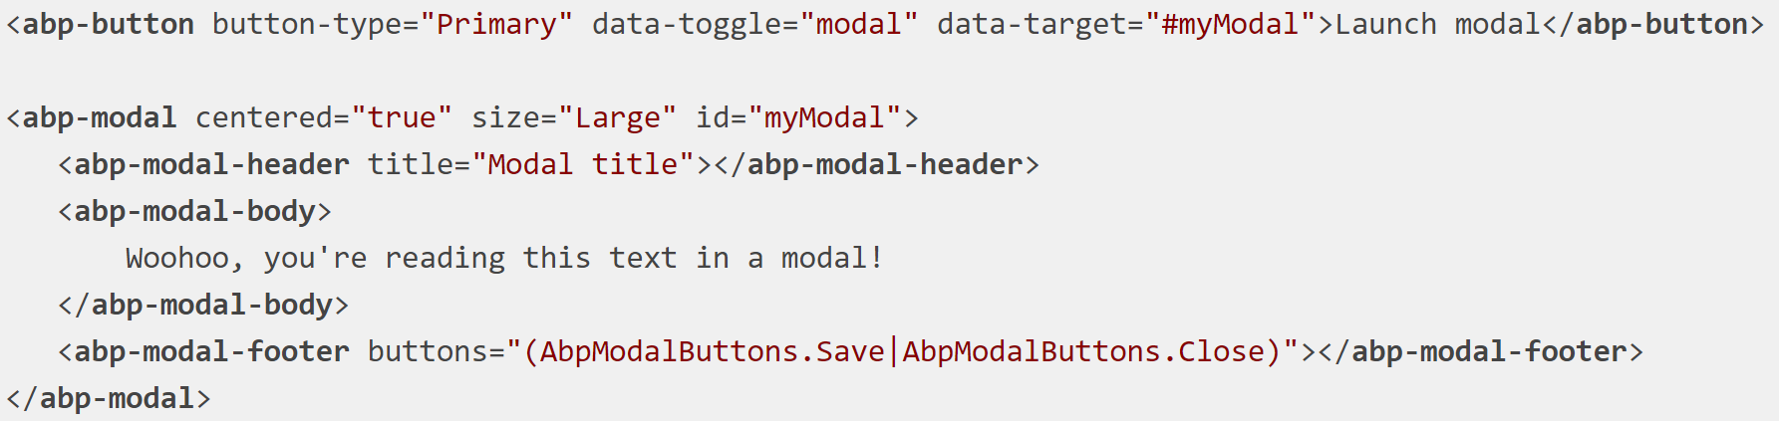
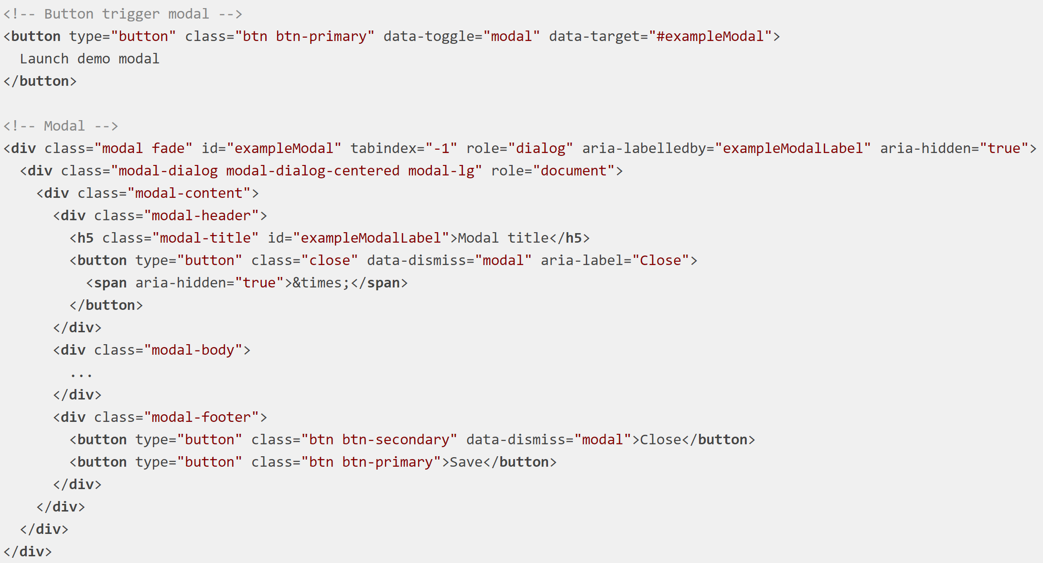
Bootstrap Tag Helpers
Native bootstrap code
Reduces boilerplate code
Get the power of the Intellisense
Cooperates with native bootstrap code

Slide 24
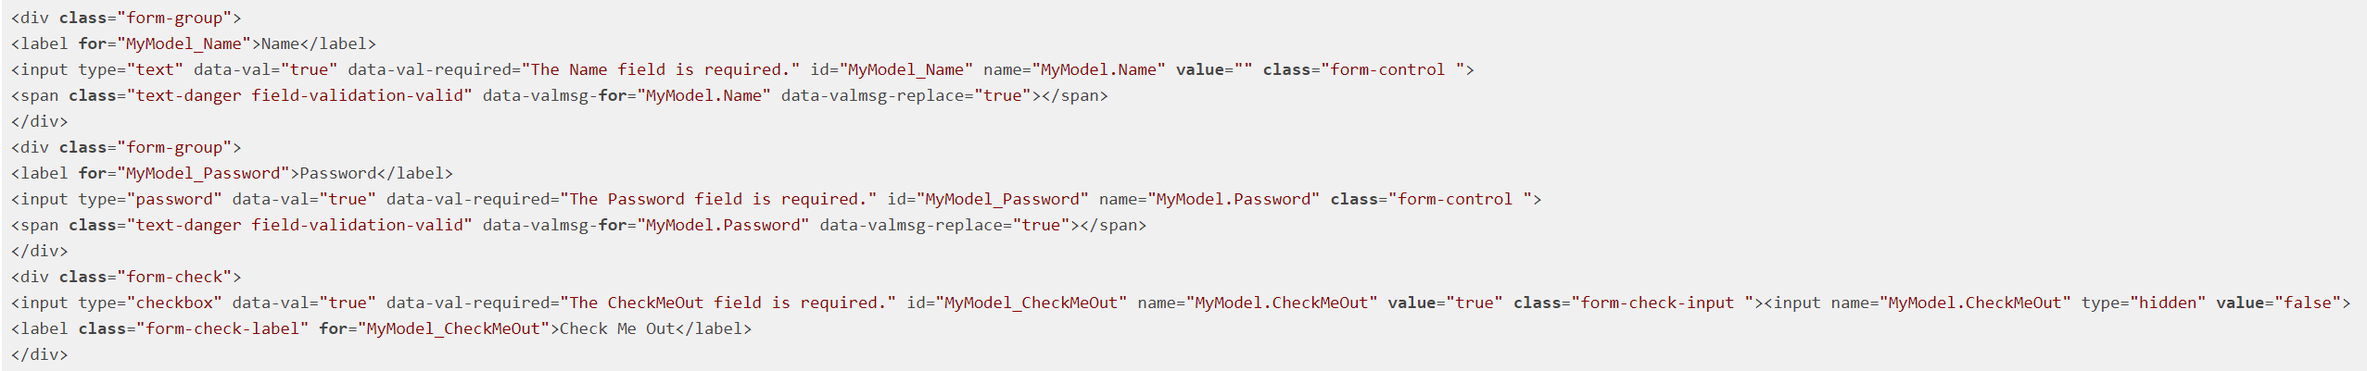
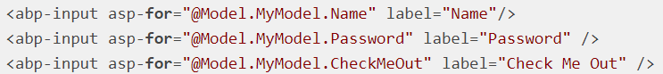
Dynamic Forms & Inputs

Slide 25
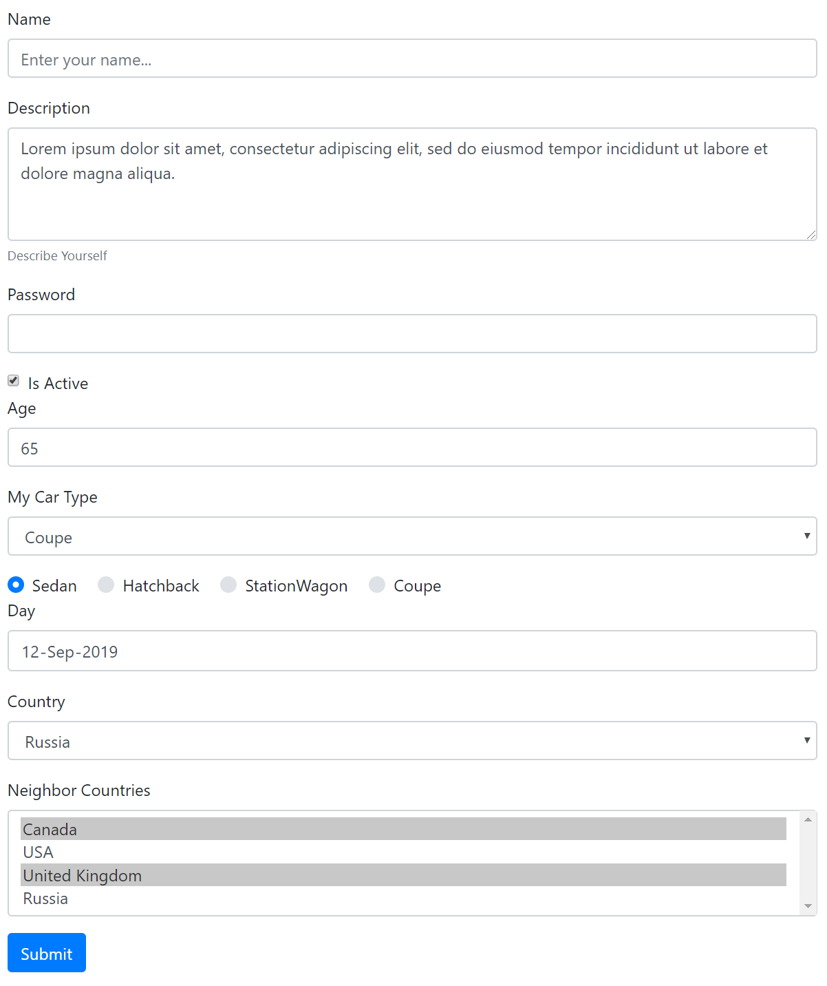

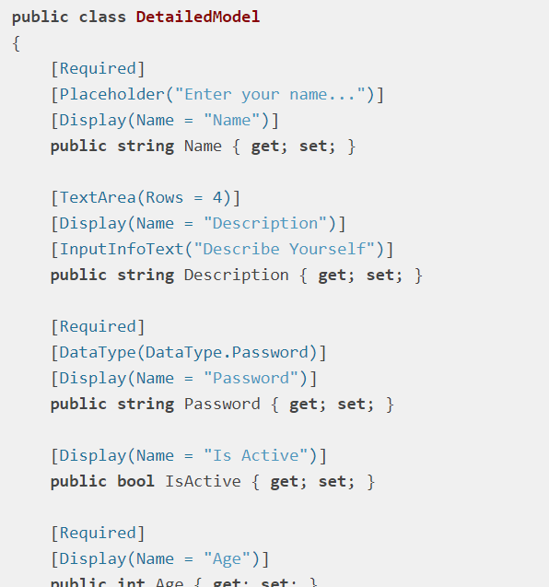
Dynamic Forms & Inputs
With
Validation &
Localization

Slide 26
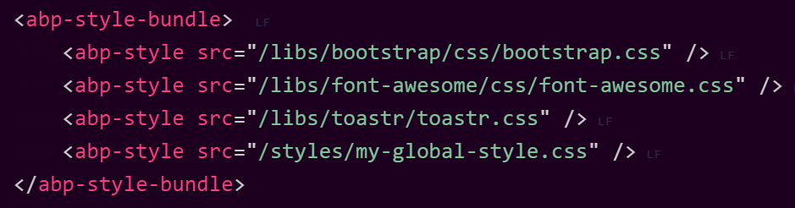
Bundling & Minification System
Auto bundling & minification on production.
Works with the Virtual File System.
Add dependencies automatically (and recursively!).
Dynamically determines the bundle contents!
Allows to create named bundles & reuse when needed!

Slide 27
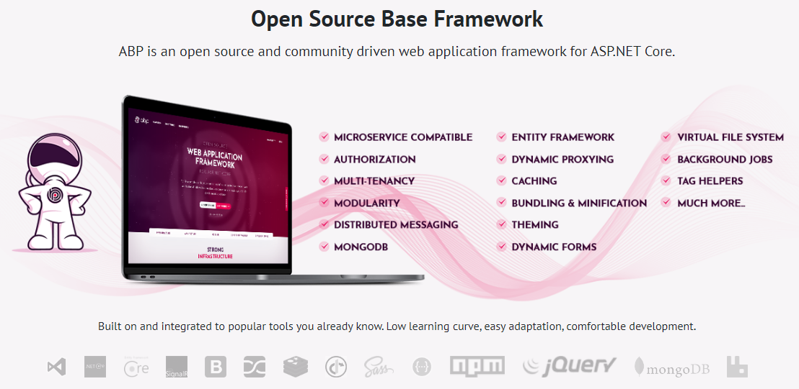
https://abp.io

Slide 28
Thanks! Questions..? Halil İbrahim Kalkan GitHub: @hikalkan Twitter: @hibrahimkalkan Web: halilibrahimkalkan.com

